Slide 1


My personal data analysis method
Jianqi. Chen
Laboratoire de Physique Corpusculaire de CAEN
chen@lpccaen.in2p3.fr
1
Jianqi Chen – Laboratoire de Physique Corpusculaire - Caen
CAEN – April 2019
Jianqi Chen – Laboratoire de Physique Corpusculaire - Caen
Notes:
1

Slide 2
Data analysis process
Data collection phase
1. Collect basic information
2. Collect experiment data
Data analysis phase
3. Manipulate data
4. Analyze data
Data visualization phase
5. Draw result
2
Jianqi Chen – Laboratoire de Physique Corpusculaire - Caen
Notes:
2

Slide 3
Data analysis process
Tool box
1. ROOT
2. Python
3. sqlite3
3
Jianqi Chen – Laboratoire de Physique Corpusculaire - Caen
Notes:
3

Slide 4
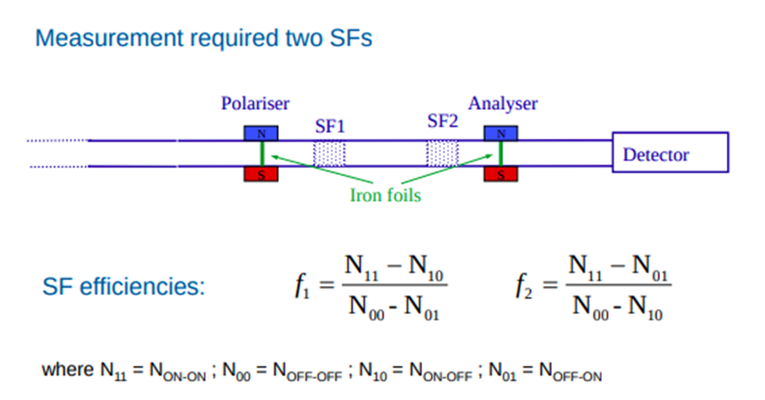
Example --- experiment @ PSI
Condition 1
Test duration: from 16/12/2019 to 20/12/2019
Number of runs: about 100 runs
4
Jianqi Chen – Laboratoire de Physique Corpusculaire - Caen
Notes:
4

Slide 5
Data analysis process
Data collection phase
5
Jianqi Chen – Laboratoire de Physique Corpusculaire - Caen
Notes:
5

Slide 6
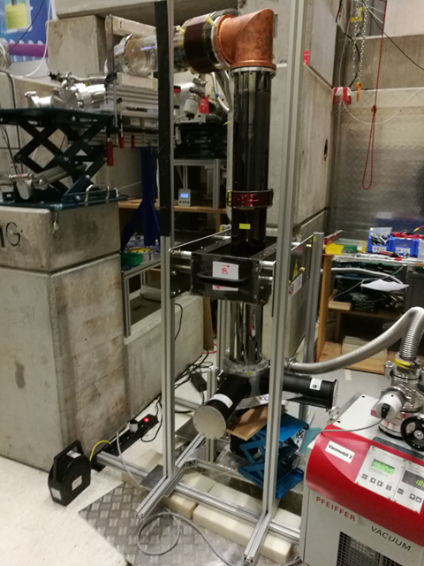
Example --- experiment @ PSI
Condition 1
Basic information:
name
beam
valve
guiding_coil_version
sf1_position
sf2_position
sf1_frequency
sf1_current
sf1_amplitude
sf2_frequency
sf2_current
sf2_amplitude
Tool used: excel or any editable file
6
Jianqi Chen – Laboratoire de Physique Corpusculaire - Caen
Notes:
6

Slide 7

Example --- experiment @ PSI
Condition 1
Time information:
file: counting_rate_test_001.setup
start_time
stop_time
duration
Tool used: python
convert_time_file_into_table.py
7
Jianqi Chen – Laboratoire de Physique Corpusculaire - Caen
Notes:
7

Slide 8
Example --- experiment @ PSI
Condition 1
Experiment data:
.fast →.root →
N_ucn_gadget_time_offset_0
N_ucn_Nanosc_1_time_offset_0
N_ucn_Nanosc_1_time_offset_0
ratio_time_offset_0
N_ucn_Gadget_time_offset_10
N_ucn_Nanosc_1_time_offset_10
N_ucn_Nanosc_2_time_offset_10
ratio_time_offset_10
N_ucn_Gadget_time_offset_20
N_ucn_Nanosc_1_time_offset_20
N_ucn_Nanosc_2_time_offset_20
ratio_time_offset_20
Tool used: ROOT and Python
convert_det_file_into_table.py
8
Jianqi Chen – Laboratoire de Physique Corpusculaire - Caen
Notes:
8

Slide 9
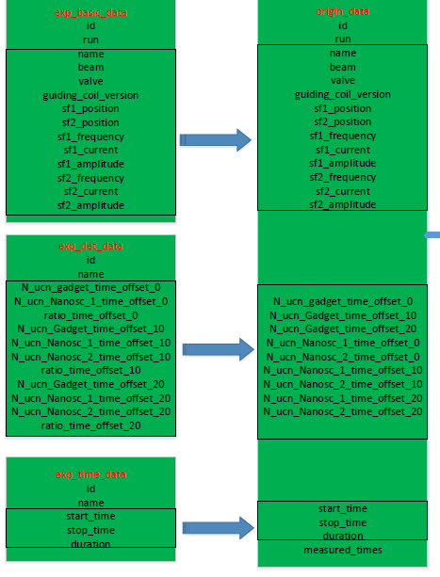
Example --- experiment @ PSI
Condition 1
Data collection part completed!
Tool used: Python and sqlite3
init.py
9
Jianqi Chen – Laboratoire de Physique Corpusculaire - Caen
Notes:
9

Slide 10
Data analysis process
Data analysis phase
10
Jianqi Chen – Laboratoire de Physique Corpusculaire - Caen
Notes:
10

Slide 11
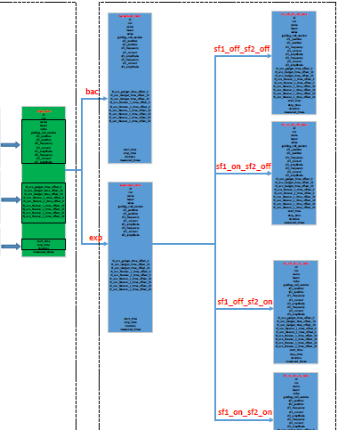
Data analysis process
---Origin data
---background_data
---experiment_data
---sf1_off_sf2_off
---sf1_on_sf2_off
---sf1_off_sf2_on
----sf2_on_sf2_on
create_table(conn, create_table11_sql)
c.execute('Insert into [{}] select * FROM [{}] WHERE beam = ? or valve = ?'.format(table11,table03),[("off"),("off")])
Remark: table03: exp table, table11: bak table
init.py
calc_sf_eff.py
11
Jianqi Chen – Laboratoire de Physique Corpusculaire - Caen
Notes:
11

Slide 12
Data analysis process
Data visualization phase
12
Jianqi Chen – Laboratoire de Physique Corpusculaire - Caen
Notes:
12

Slide 13
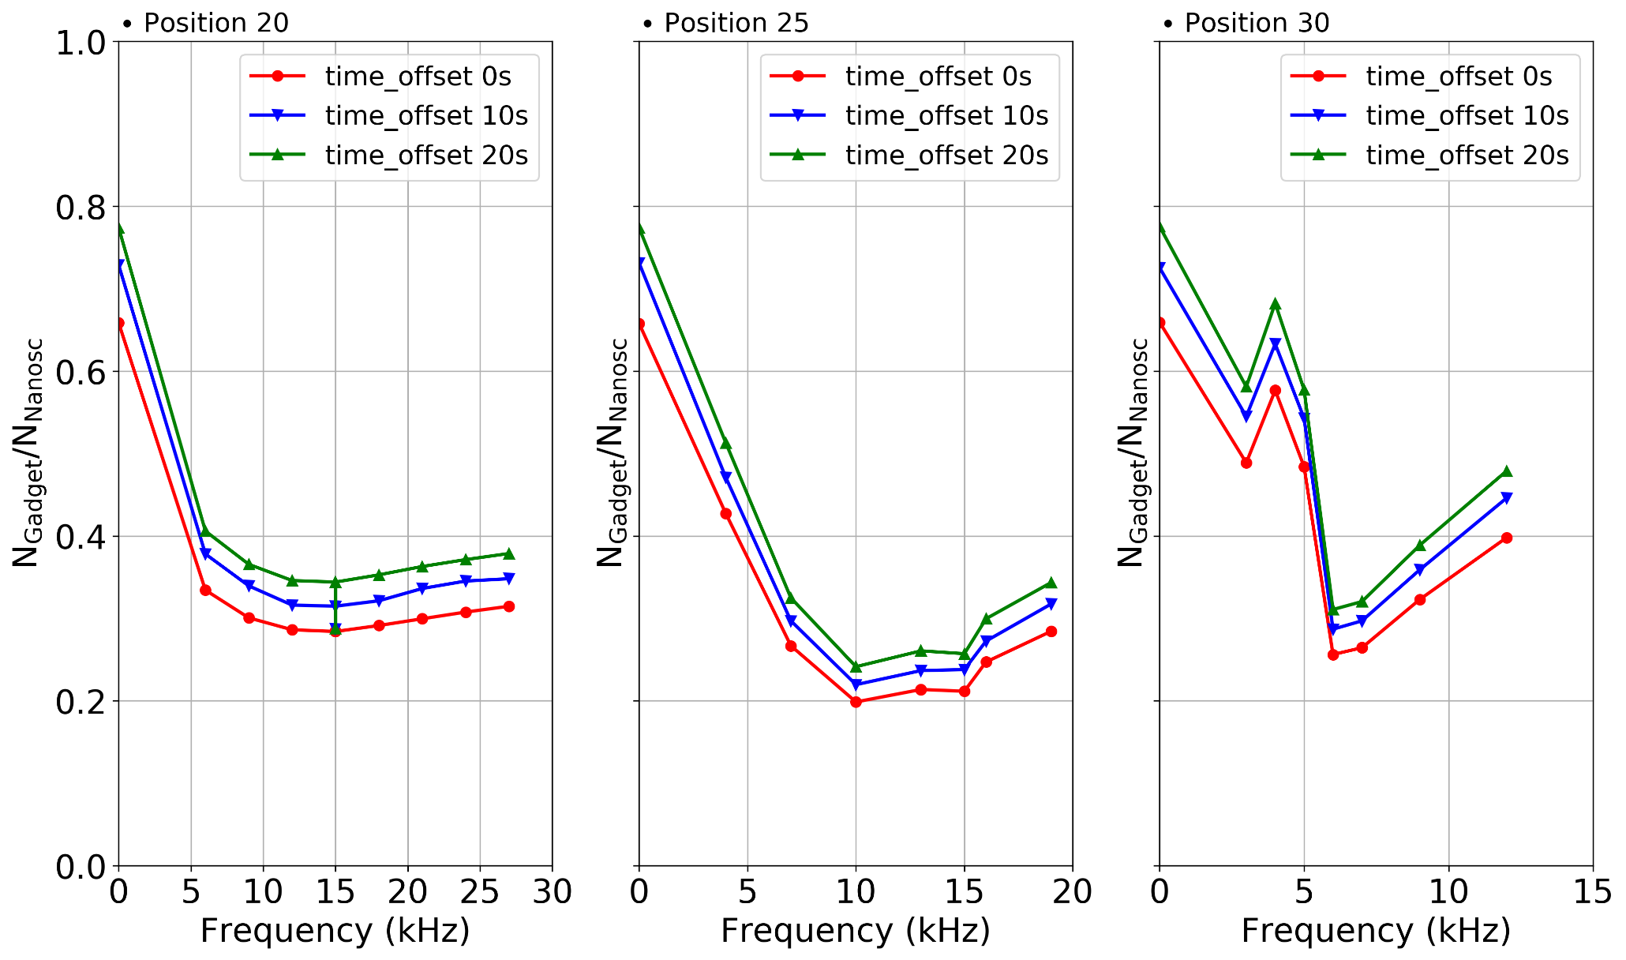
Data visualization
Exp1：SF1_OFF_SF2_ON_Tests
---Origin data
---background_data
---experiment_data
---sf1_off_sf2_off
---sf1_on_sf2_off
---sf1_off_sf2_on
----sf2_on_sf2_on
create_table(conn, create_table11_sql)
c.execute('Insert into [{}] select * FROM [{}] WHERE beam = ? or valve = ?'.format(table11,table03),[("off"),("off")])
drawResultPlot3.py
13
Jianqi Chen – Laboratoire de Physique Corpusculaire - Caen
Notes:
13

Slide 14
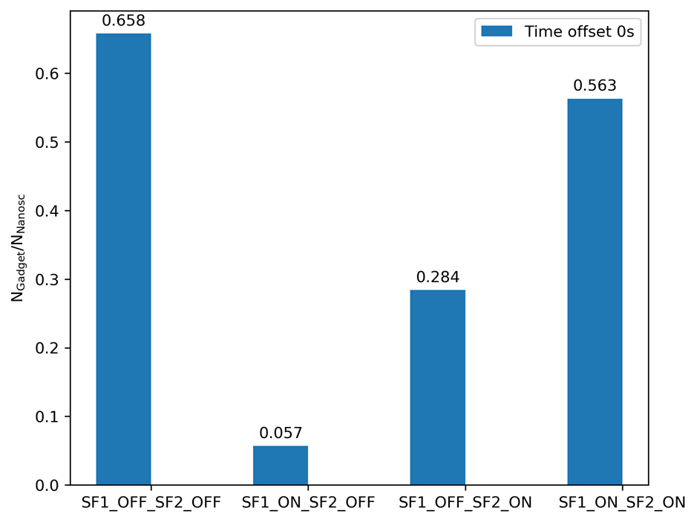




Data visualization
Exp 2：Spin efficiency calcualtion
$$f_{1}=135.2\%$$
$$u_{1}=0.8\%$$
$$f_{2}=46.5\%$$
$$u_{2}=0.2\%$$
drawResultPlot4.py
14
Jianqi Chen – Laboratoire de Physique Corpusculaire - Caen
Notes:
14

Slide 15
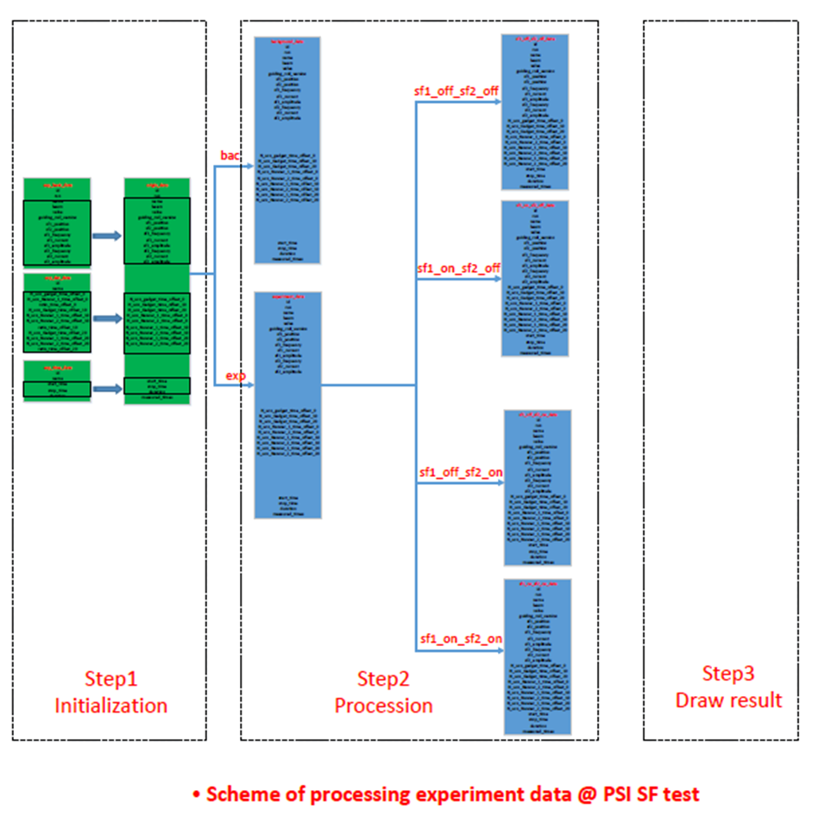
Data visualization
Library: matplotlib
https://matplotlib.org/
Another software
recommend: gnuplot
http://gnuplot.sourceforge.net/demo_5.3/
15
Jianqi Chen – Laboratoire de Physique Corpusculaire - Caen
Notes:
15

Slide 16
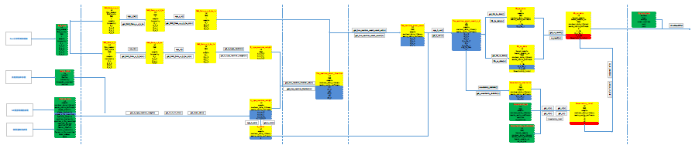
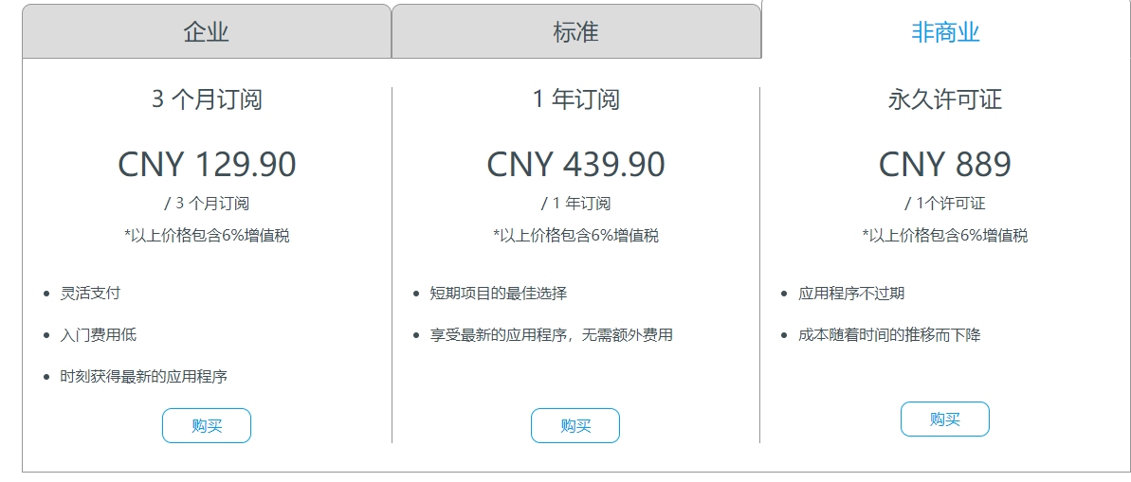
Data visualization
Software: visio
Visualization software: Navicat
16
Jianqi Chen – Laboratoire de Physique Corpusculaire - Caen
Notes:
16

Slide 17
Data analysis process
some tips
17
Jianqi Chen – Laboratoire de Physique Corpusculaire - Caen
Notes:
17

Slide 18
Data analysis process
1. Use block diagram to instruct your coding.
2. Use Elog to record your experiment.
3. Use cheatsheet to check commands.
4. Use customized template to simplify your code.
5. Save your codes on source code hosting
site(github or bitbucket).
18
Jianqi Chen – Laboratoire de Physique Corpusculaire - Caen
Notes:
18

Slide 19
Data analysis process
Thank you!
19
Jianqi Chen – Laboratoire de Physique Corpusculaire - Caen
Notes:
19

